Slide 1
VISUAL BRANDING
This slide deck was developed by the Smithsonian Institution in collaboration with BGCA for "Youth for Unity: Teen Changemakers.”

Slide 2
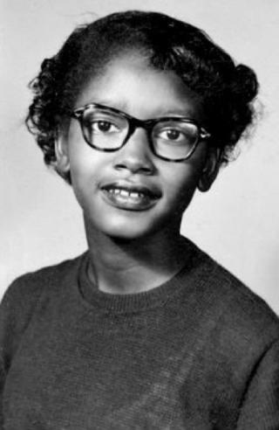

Youth for Unity: Teen Changemakers
Claudette Colvin, Teen Changemaker
How can teens create a more equitable nation? Let's look at history, think about what motivates us, and think about the changes we can make in our world!
Unknown. Claudette Colvin at age 13, April 20, 1953. Wikimedia Commons

Slide 3
What will we do?
Session 1 | Session 2 | Session 3 | Session 4 | Session 5
Building Community​ | I Know My Value(s) | Not Alone: Support and Inspiration | The Change I Wish to See​ | Creating the Future We Imagine Together​
Notes:
Building Community
Connect as a community through artworks and build Group Agreements that set a foundation for working together.
I Know My Value(s)!
Explore the life and legacy of Claudette Colvin and discover how our values impact our decisions.
Not Alone: Support & Inspiration
Learn about Claudette Colvin’s role models and consider how your own support systems help you navigate the world.
Facilitator note: Due to the charges unjustly levelled against him, Jeremiah Reeves’ biography does include material of a sensitive nature. Please take care.
The Change I Wish to See
Consider the many types of actions you might take to create change in your community. Then draft designs that address issues you care about.
Creating the Future We Imagine Together
Refine your design based on reflection and peer feedback, then share your work with the group and be recognized.

Slide 4
Session 1: Building Community
Connect as a community through artworks and build Group Agreements that set a foundation for working together.

Slide 5
Welcome!
HELLO
my name is
Gary
August
Make a name tag with your preferred name and your birth month.
Feel free to be artistic.

Slide 6

Vibe check.
What's your energy today?
0 = none, zzzz...
1 = low
5 = A LOT, gotta move!

Slide 7

Timed Pair-Share
Pair one: Find someone who has the same birth month as you. What is your favorite dessert or sweet treat?
Pair two: Find someone whose name has at least one letter in common with yours. What's a song that's giving you life right now or you really enjoy?
Pair three: Find someone who you have NOT talked to yet. What’s your favorite thing about our Boys & Girls Club?

Slide 8
Four Freedoms
Freedom from Fear: No one should live in fear for their personal safety.
Freedom from Want: Every person can make ends meet and feel secure and content.
Freedom of Worship: Every person can worship in their own way, and differences in belief are accepted.
Freedom of Speech: Every person can express their thoughts and opinions freely.
Images:
Four Freedoms by Normal Rockwell
Pair up and choose one freedom to discuss.

Slide 9

Paired Discussion
Look at the image with your partner:
What do you see? List three things you can point to.
What story does the picture tell?
Think about the freedom you and your partner chose:
How does the image connect to that freedom?
How might you tell the story of that freedom?

Slide 10
Quick Compare
Compare the 1943 image with the 2018 image of the same freedom. Talk to your partner:
  What has changed?
  What do you think about those changes?
Artists’ response images to the Four Freedoms (2018)

Slide 11

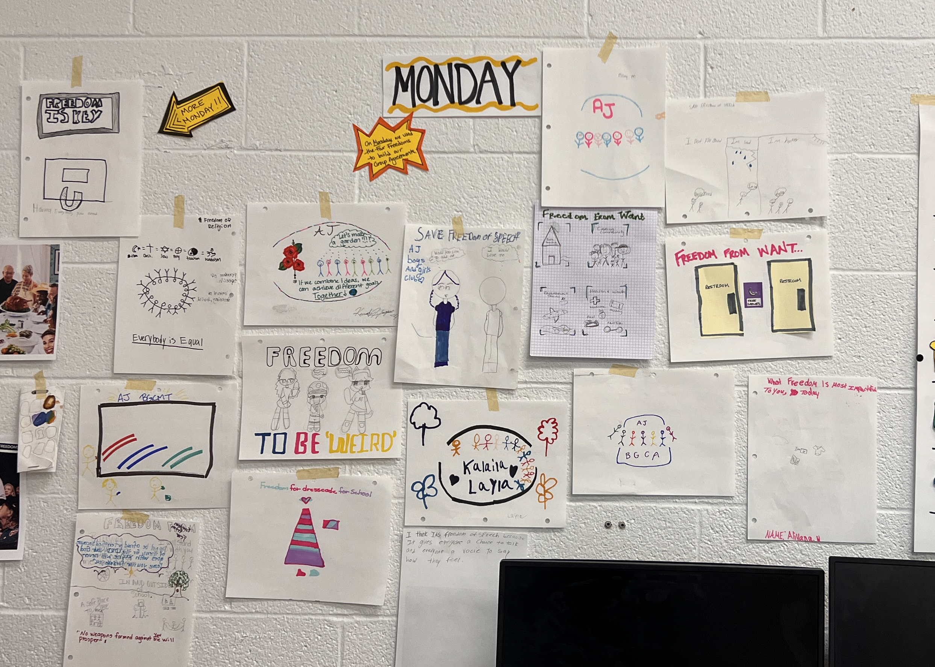
On your own...
Choose one freedom (it can be a new one).
THINK: How do you want that freedom to show up at the Club? How do we make sure that, here, people can...
      … Freedom of speech: say what they think?
      … Freedom of worship: believe what they believe?
      … Freedom from want: have what they need?
      … Freedom from fear: know they are safe here?
SKETCH: Create a draft image of your version of that freedom.

Slide 12

Group Agreements
How can we make sure that everyone in this program can
... say what they think?
... believe what they believe?
... have what they need?
... know they are safe here?

Slide 13


Reflect
Recognize
Which freedom is most impactful to you today?
What can we do together to ensure that this freedom shows up at our Club and in our communities?
What symbol could stand for that action? Draw it!
Recognize youth who gave you a new idea today.
Either give them a fist bump or tell them!
Next time: Let's talk values!

Slide 14

Closure
Please clean up the area and return all the materials to their designated spaces.
Recycle or reuse all paper products and consumable materials.
Add your work to the documentation wall.

Slide 15
Session 2: I Know My Value(s)!
Explore the life and legacy of Claudette Colvin and discover how our values impact our decisions and actions.

Slide 16
Welcome & Vibe Check
What's your mood right now? Add a dot.

Slide 17

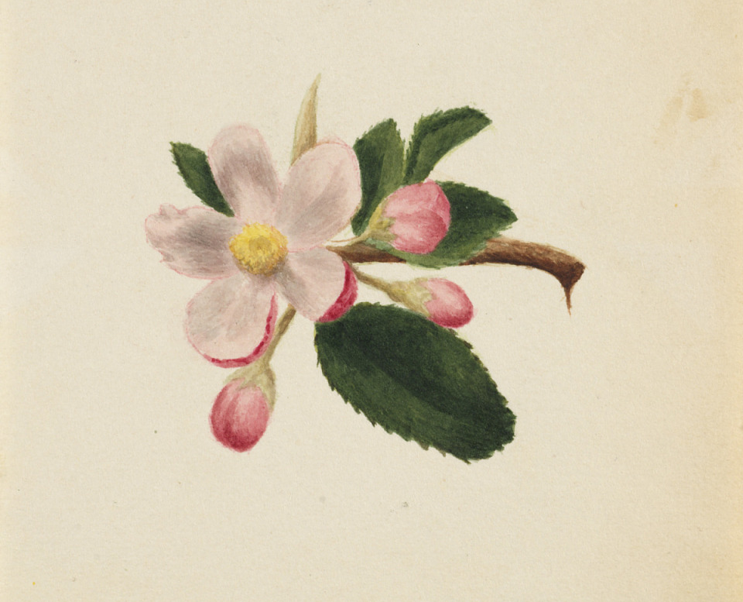
Free association activity image 1 of 6
Mary Vaux Walcott, (Untitled--Flower Study), ca. 1876, watercolor on paper, Smithsonian American Art Museum, Gift of the artist, 1970.355.806

Slide 18
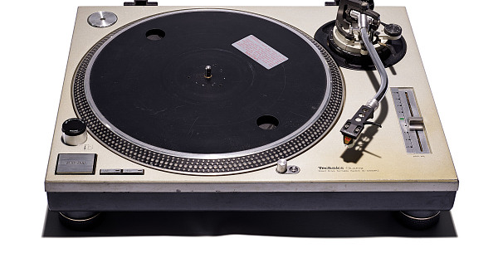
Free association activity image 2 of 6
Technics Turntable, used by Grandmaster Flash, Division of Culture and the Arts, National Museum of American History, Smithsonian Institution. Gift of Grandmaster Flash.

Slide 19
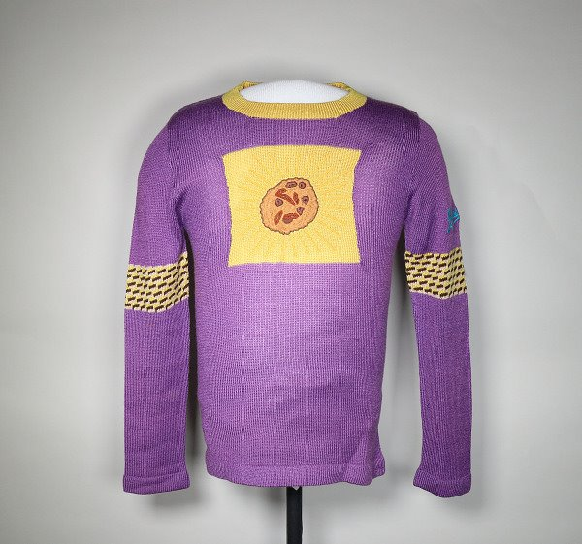
Free association activity image 3 of 6
Sweater, Division of Work and Industry, National Museum of American History, Smithsonian Institution.

Slide 20
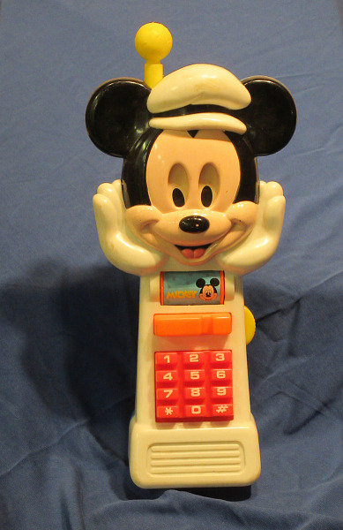
Free association activity image 4 of 6
Arco "Mickey Mouse" toy cellphone, Division of Work and Industry, National Museum of American History, Smithsonian Institution.

Slide 21
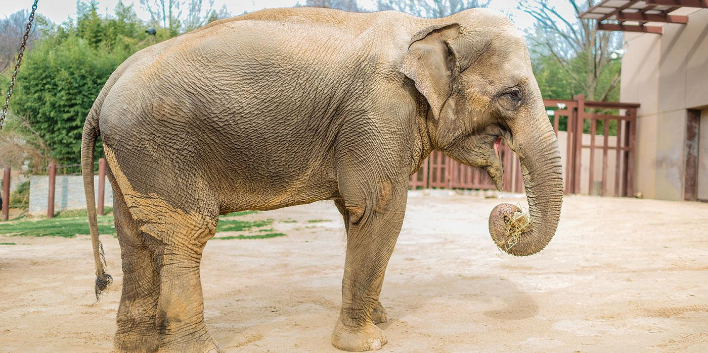
Free association activity image 5 of 6
Elephant: Adam Mason, Smithsonian’s National Zoo and Conservation Biology Institute

Slide 22

Free association activity image 6 of 6
Schweizer SGU 2-22EK: Smithsonian National Air and Space Museum (A19751349000).

Slide 23
Group Agreements
Does everyone commit to our Agreements today?
Is there anything we need to add?

Slide 24
Value: an idea you carry with you that impacts how you treat others and how you act in the world
Freedom
Equality
Diversity
Community
Independence
Respect
Love
Curiosity
Justice
Helping Community
Family
Safety

Slide 25
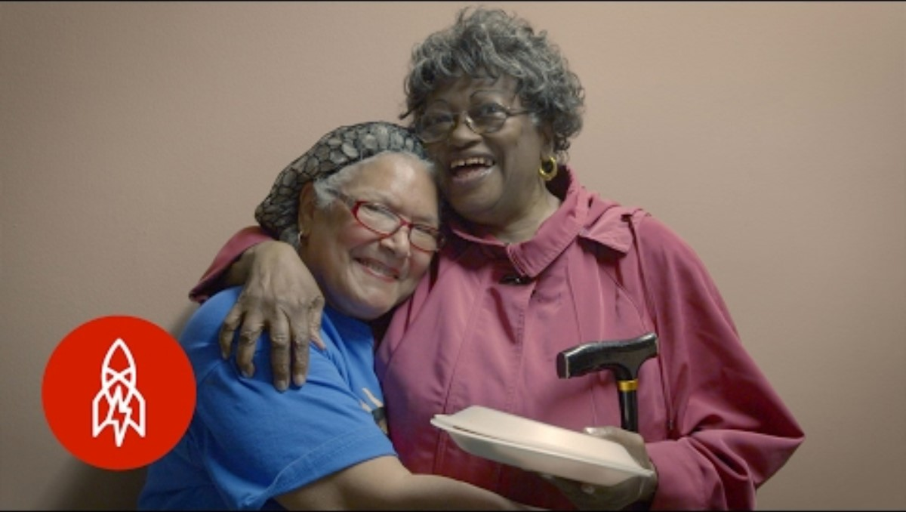
Main Activity: Meet Claudette Colvin
Video by "Great Big Story," April 2016.
Around the same time Rosa Parks famously protested segregation by refusing to give up her bus seat to a White passenger, a teenager named Claudette Colvin went to jail in Montgomery, Alabama, for doing the exact same thing. This is her story.

Slide 26
What is one value that motivated Claudette Colvin?
Freedom
Equality
Diversity
Community
Independence
Respect
Love
Curiosity
Justice
Helping Community
Family
Safety
Claudette Colvin acted against segregation of buses. She did this from a value system that included __________ and ___________.

Slide 27

Image Walk
THINK: What are two values that influence the way you treat others and act in the world? Write one on each of your cards.
WALK: Take a walk around the room to look at the images. Which one could be a symbol for each of your values? Tape your values to the images that resonate.
LOOK: Take a second walk. This time, notice which values people connected with the images.
TALK: Let's think together!

Slide 28
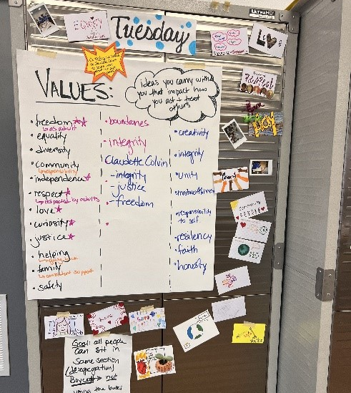
Reflect
What: What values motivate you?
So, what: What new ideas do you have about yourself as a changemaker?
Now, what: How could you use your values to make decisions or take actions?
BGCMT Club pictures. Office of the Under Secretary for Education. Photo by Ashley Naranjo.

Slide 29
Recognize
Closure
Please clean up the area and return all the materials to their designated spaces.
Recycle or reuse all paper products and consumable materials.
Add your work to the documentation wall.
Write ONE of your values as an affirmation on a sticky note. “[Name] is ________."
Place yours on the wall near the Group Agreements.
Next time: We've got
INSPIRATION!

Slide 30
Session 3:
Not Alone: Support and Inspiration
Learn about Claudette Colvin’s role models and consider how your own support systems help you navigate the world.

Slide 31












Welcome & Vibe Check
Which emoji goes with your mood or state of mind today?
Share your answer with a peer.

Slide 32
Community Builder: Head-to-Head

Slide 33
Community Builder: Head-to-Head
A
C
🙂
😍
1
👍🏾
❤️
B
D
🤣
2
🙄
💀
💅🏾
WINNER

Slide 34
Group Agreements
Does everyone commit to our Agreements today?
Is there anything we need to add?

Slide 35
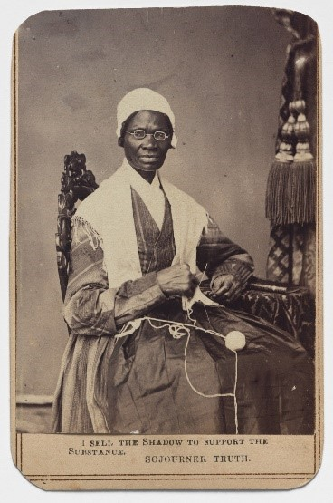
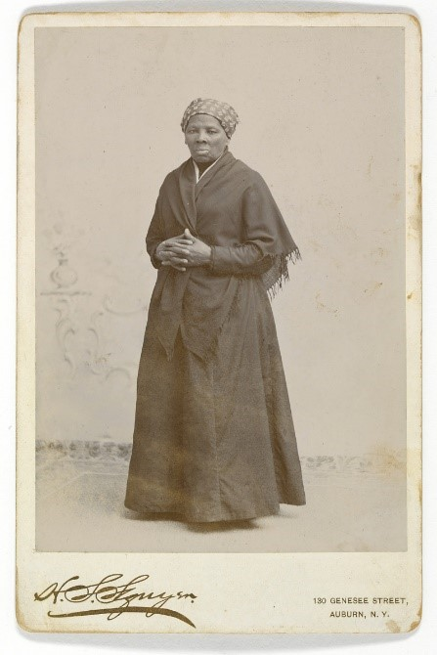
Inspiration From History
"It felt as if Harriet Tubman’s hand was pushing me down on the one shoulder, and Sojourner Truth’s hand was pushing me down on the other. Learning about those two women gave me the courage to remain seated that day.”
- Claudette Colvin
Sojourner Truth
Harriet Tubman
Sojourner Truth (1864). National Portrait Gallery, Smithsonian Institution.
Harriet Tubman (c. 1885), National Portrait Gallery, Smithsonian Institution.

Slide 36
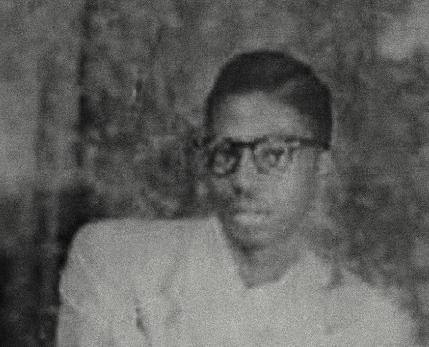

Community Inspiration
Jeremiah Reeves
Josie Lawrence
Geraldine Nesbitt
Jeremiah Reeves, Jr. holding a cymbal (detail), Alabama Department of Archives and History.

Slide 37
Main Activity 1:
Your Community Inspiration
Heal WITH each other
Be OK with saying "NO"
Cultivate calm
Listen to different ideas
Find fun
GROUP BRAINSTORM
What do our values look like in action?
Welcome everyone
Persevere through challenges
Stand up for a friend
Check in on each other

Slide 38
Main Activity 1:
Your Community Inspiration
Movie Star
Pastor/
Worship Leader
Peer/ Friend
Neighbor
Coach
Family Member
Club Staff
INDIVIDUALLY
Who are two people in your life who model your values through their actions?
Write down their names, the value they each model for you, and an example of how they model that value.
Athlete
Historical Figure

Slide 39
My Role Models and Inspiration
 | The value they model for me is … | They model that value by ….
Name 1: NAME
Name 2: NAME
Value 1
Two sentences
Value 2
Two sentences​

Slide 40
Main Activity
Make a group chat for you and your role models.
What emoji would you use as your contact picture?
What emoji would you use for Claudette Colvin’s contact picture?
What emoji would you use for the two people who inspire you?
What is the group chat name?
OPTIONAL: How would you introduce Claudette Colvin to your role models in the chat? How would you introduce your role models to Claudette Colvin?
* Use the group chat organizer to help you with this activity.

Slide 41
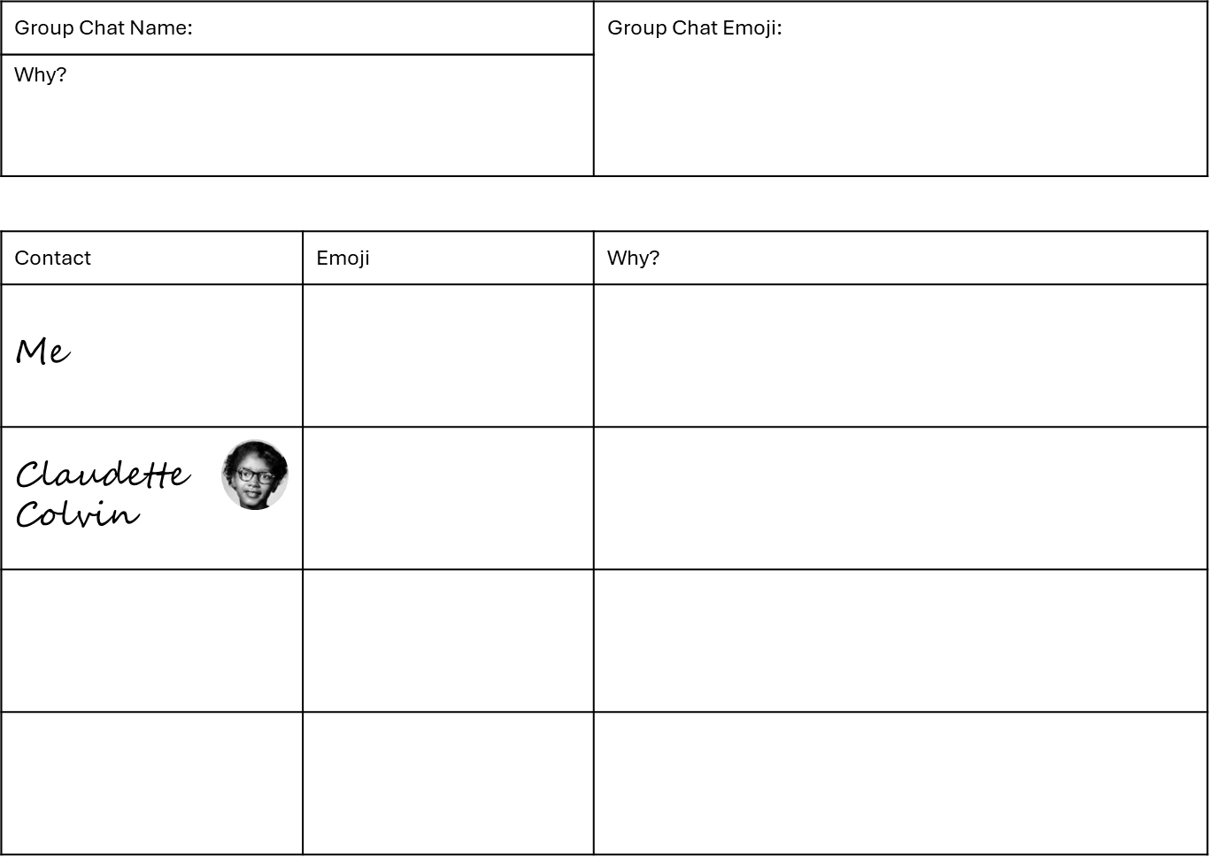
Group chat organizer template

Slide 42
Reflect
Partner Share
What: What is one emoji you chose?
So, what: So, what does that choice tell you about your role model?
Now, what: Now, what can you do to be a role model for others?

Slide 43
Recognize
INDIVIDUALLY
Pick one person from our Club or your group chat and write them an acknowledgement on an index card.
How might you share this acknowledgement?
Dear ________,
Thank you for ____________________
__________________________________
______________________.
I appreciate _____________________
____________________________.
[Your name]

Slide 44
Closure
Please clean up the area and return all the materials to their designated spaces.
Recycle or reuse all paper products and consumable materials.
Add your work to the documentation wall.
Next time: We'll talk ISSUES!

Slide 45
Session 4: The Change I Wish to See
Identify ways to make positive change on issues we care about.
Notes:
EDD

Slide 46
Community Builder
Round 1 (2 minutes)
Work together to come to consensus!*
Look through the eight images together.
Sort the images into three categories:
    Protest (to resist, object, call to action)
    Inform (to tell, raise awareness)
    Celebrate (to elevate, remember)
*Consensus = general agreement among people

Slide 47
Community Builder
Round 2 (5 minutes)
Let’s see everyone’s choices! Travel the room to see how other groups categorized the images. Think about the following:
    What do you notice about the other groups’ categories?
    What questions could you ask to better understand their thinking?

Slide 48
Group Agreements
Does everyone commit to our Agreements today?
Is there anything we need to add?

Slide 49
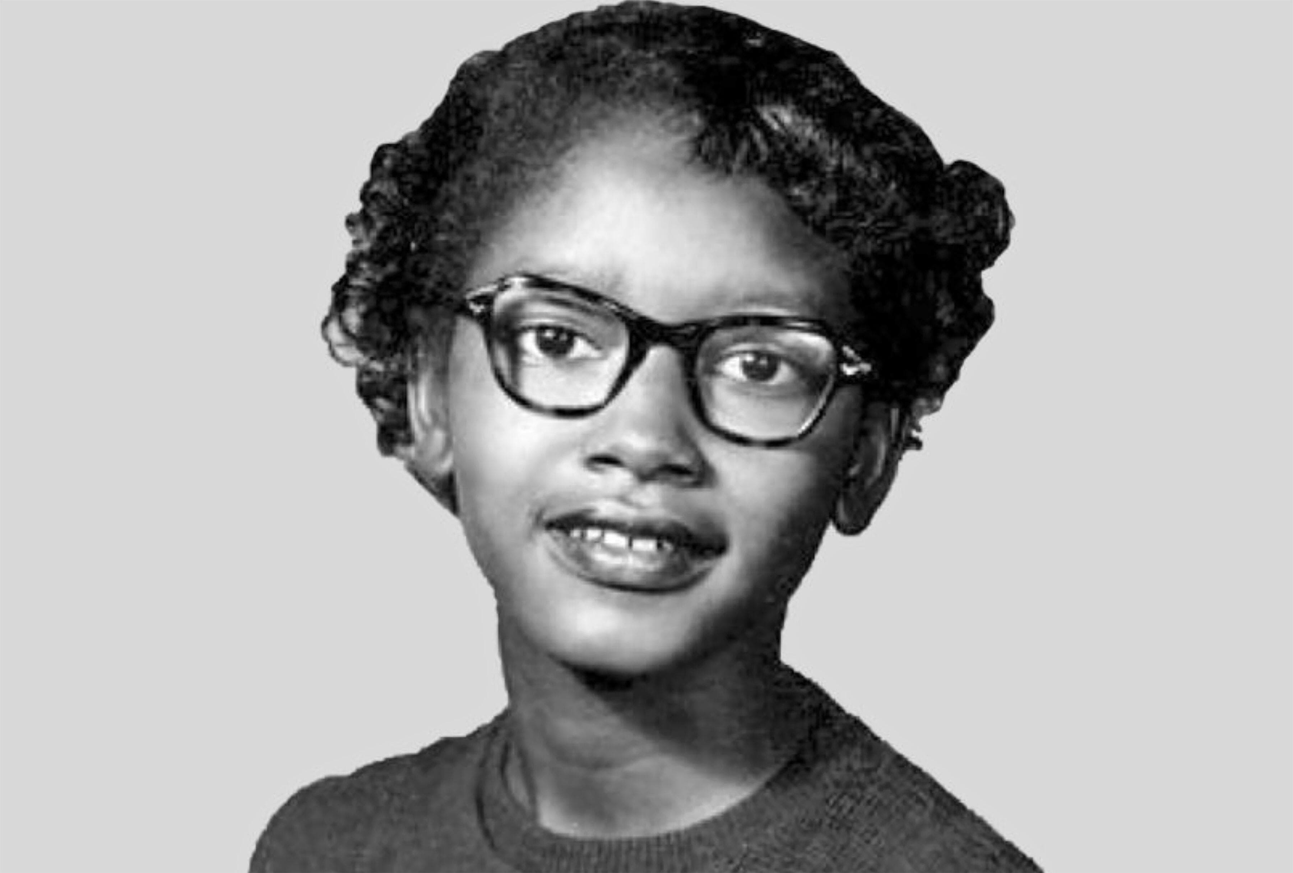
Claudette Colvin Roadmap to Action
Issue | Role Models | Values | Action | Outcome
Racism and segregation |  | Justice Fairness "I paid my fare. It's my constitutional right." | PROTEST: Refused to give up her seat, knowing she would get in trouble. Participated in a lawsuit that challenged segregation on public buses. | NAACP Montgomery Bus Boycott began in December 1955. Browder vs. Gale On June 5, 1956, the panel ruled that segregation on Alabama's intrastate buses was unconstitutional

Slide 50
Roadmap to Action — Step One
LARGE-GROUP BRAINSTORM:
What are issues that your community faces?
Are any of these reflected in the sorting activity?
What kinds of action might be possible?

Slide 51
Roadmap to Action – Step Two
INDIVIDUALLY
Choose one issue from the list that matters to you.
Write:
  Why does that issue matter in my community?
  Why does that issue matter to me?
  How does this connect to my values?
  What do I want people to know about that issue?

Slide 52
Reflect
INDIVIDUALLY
What did you discover about ways to make change?
So, what do you think teens can do as changemakers?
Now what could you do with that idea?

Slide 53
Recognize
INDIVIDUALLY
Write down a skill that you saw someone use today. Phrase it as an affirmation.
Drop it in the box for someone else to take as a reminder.
I am __________.

Slide 54
Closure
Please clean up the area and return all the materials to their designated spaces.
Recycle or reuse all paper products and consumable materials.
Add your work to the documentation wall.
Take an affirmation!
Next time: Refine your work!

Slide 55
Session 5: Creating the Future We Imagine Together
Create T-shirt designs to bring awareness to a community issue, and then share your work with the group to be recognized.

Slide 56
Community Builder
IN PAIRS
Discuss the issue you chose and how you might design T-shirts to raise awareness. Consider discussing the following:
    “Why is this issue important?”
    “How do I want others to respond to my design?”

Slide 57
Group Agreements
Does everyone commit to our Agreements today?
Is there anything we need to add?

Slide 58
Roadmap to Action – Step One
What T-shirt image could you create that either:
  Raises awareness about that issue?
  Protests an injustice related to that issue?
  Celebrates someone doing something to address the issue?

Slide 59
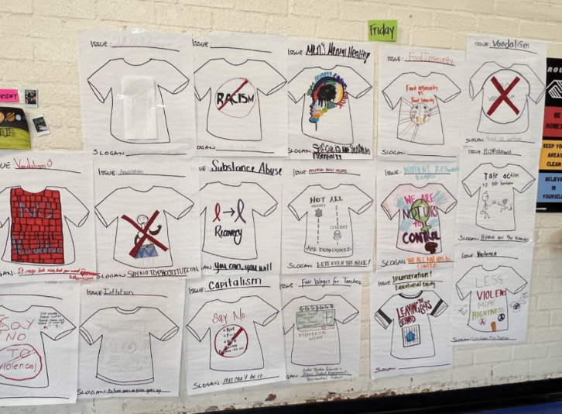
Work Time
INDIVIDUALLY
Sketch a design that either:
  Raises awareness about the issue,
  Protests an injustice related to the issue, or
  Celebrates someone doing something to address the issue.
BGCMLA Club pictures. Office of the Under Secretary for Education. Photo by Ashley Naranjo.

Slide 60

T-Shirt Gallery Walk
WHOLE GROUP
  Post your T-shirt design on the wall.
  Walk around the room observing everyone’s work.
  Think about and discuss the following:
  What similarities did you notice in the designs?
  What questions or ideas do you have?
  What strengths or skills do you have in your community?
  What are ways that we might help with these issues?

Slide 61
Reflect
INDIVIDUALLY
What did you enjoy doing during this program?
Why does that matter to you?
What can you do with this work in the Club?

Slide 62
Recognize
Take your reflection from Day 1 off the wall and read the back silently.
  What’s one word from your Day 1 writing that stands out to you today?
  Is there someone here who embodies that word for you? Share your word with them and why you chose it.

Slide 63
Closure
Please clean up the area and return all the materials to their designated spaces.
Recycle or reuse all paper products and consumable materials.

Slide 64
Image Credits
Jeremiah Reeves, Jr. holding a cymbal, Alabama Department of Archives and History.
Sojourner Truth (1864). National Portrait Gallery, Smithsonian Institution.
Harriet Tubman (c. 1885), National Portrait Gallery, Smithsonian Institution.
ULBGC youth work [Claudette Colvin by Giovanni]. Office of the Under Secretary for Education. Photo by Elizabeth Dale-Deines.
BGCMLA Club pictures. Office of the Under Secretary for Education. Photo by Ashley Naranjo.
BGCMT Club pictures. Office of the Under Secretary for Education. Photo by Ashley Naranjo.
Unknown. Claudette Colvin at age 13, April 20, 1953. Wikimedia Commons

